Slide 1


Write RestAPI with Express-Nodejs
In this lession, you will learn:
- Setup NodeJS app with Express,mysql
- Understanding of POST, GET, PUT, ….methods
- Write Restful API with Express.Router
- Connect MySQL Database with Sequelize
- Upload images to NodeJS Server
- Authentication in NodeJS

Slide 2
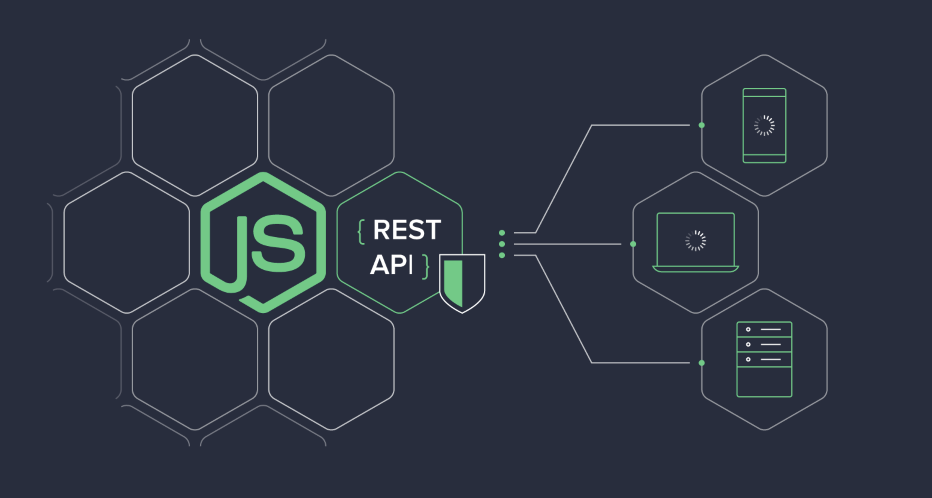
Write RestAPI with Express-Nodejs
Express is one of the most popular web frameworks for Node.js that supports routing, middleware, view system.

Slide 3
Create a simple server route
Setup Express web server. In the root folder, let’s create a new server.js file. body-parser helps to parse the request and create the req.body object
const express = require("express")
const bodyParser = require("body-parser")
const cors = require("cors")//Cross-Origin Resource Sharing
const app = express()
app.use(cors({origin: "http://localhost:3001"}))
app.use(bodyParser.json()) // parse requests of content-type - application/json
app.use(bodyParser.urlencoded({ extended: true }))
app.get("/", (req, res) => {// simple route
res.json({ message: "Hello World" })//let debug for testing
})
const PORT = 3002 // set port, listen for requests
app.listen(PORT, () => {
console.log(`Server is running on port ${PORT}.`)
})

Slide 4
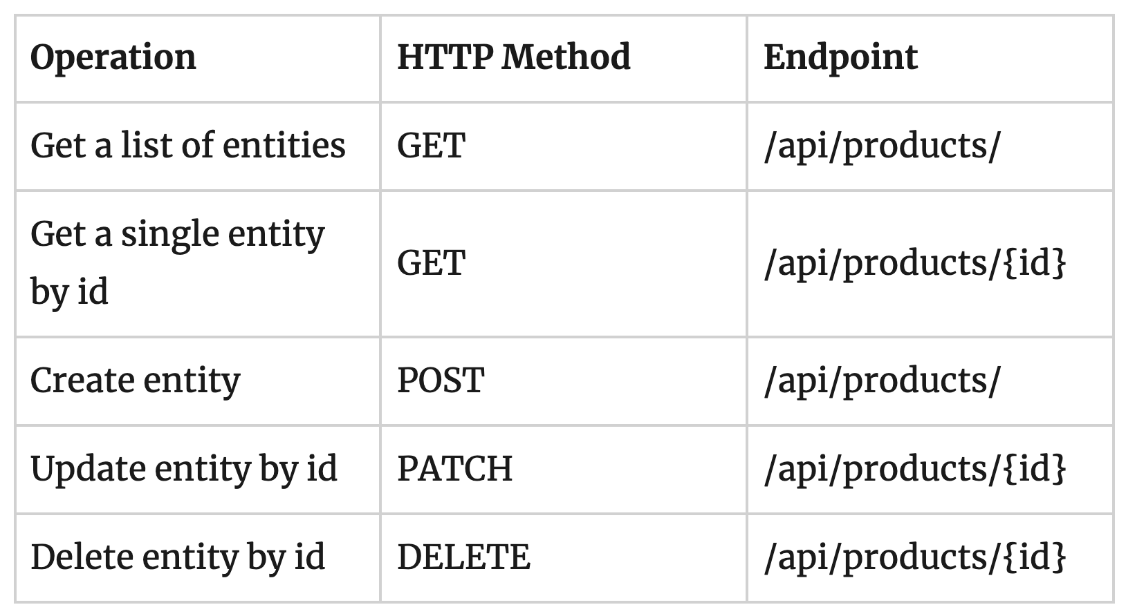
Example of REST service Enpoints

Slide 5
Usage with express.Router
Use the express.Router class to create modular, mountable route handlers
//In routes/products.js
var router = express.Router()
router.get('/', function (req, res) {
res.send('Maybe GET /products')//replace with res.json ?
})
router.('/', function (req, res) {
res.send('Maybe POST /products')//try other method: PUT, DELETE
})
module.exports = router
//In server.js
const products = require('.routes/products')
app.use('/products', products) //1 Entity => 1 Route

Slide 6
Configure MySQL database & Sequelize
Create a separate config folder for configuration with db.config.js file like this:
module.exports = { //why places this code in a separated file ?
HOST: "localhost",
USER: "root",
PASSWORD: "123456",
DB: "testdb",
dialect: "mysql",
pool: {
max: 5,//maximum number of connection in pool
min: 0,
acquire: 30000,//try to connect(ms) before throwing error
idle: 10000//maxtime(ms),connection can be idle before being released
}
}

Slide 7
Initialize Sequelize DB
Create a js file which init db Object like this(in models/index.js):
const dbConfig = require("path to db.config.js");
const Sequelize = require("sequelize");
const sequelize = new Sequelize("config from dbConfig, how to get ?");
const db = {Sequelize, sequelize}
db.Product = require("path to model.js")(sequelize, Sequelize);
//db.User = ...
//db.OtherEntity = ...
db.sequelize.sync(); //can be placed in server.js.
module.exports = db;

Slide 8
Define the Sequelize Model
Create product.model.js file like this:
module.exports = (sequelize, Sequelize) => {
const Product = sequelize.define(”product", { //table name in MySQL
name: {
type: Sequelize.STRING
},
description: {
type: Sequelize.STRING
},
//what about other fields ?
})
return Product;
//if there are more entity, how should you do ?
}

Slide 9
Create the Controller
Let’s create controllers/tutorial.controller.js with these CRUD functions: create, findAll, findOne, update,...
const db = require("../models");
const {Product} = db.Product;
const Op = db.Sequelize.Op;
// Create and Save a new Product
exports.create = (req, res) => {
};
// Find a single Product with an id
exports.findOne = (req, res) => {
};
// Other requests...

Slide 10
CRUD Functions in Sequelize
Let’s create controllers/tutorial.controller.js with these CRUD functions: create, findAll, findOne, update,...
const {name, description} = req.body// Get input data & Save to database
Product.create({name, description})
.then(data => { //what about async/await
res.send(data)//How about res.json ?
})
.catch(err => {
res.status(500).send({
message:
err.message || "Some error occurred while creating Product."
})
})

Slide 11
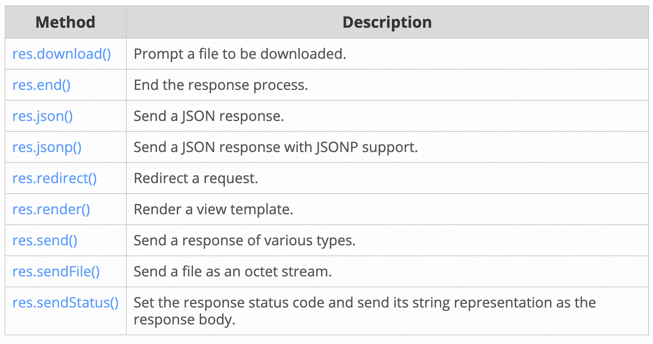
Response methods
The methods on the response object (res) in the following table can send a response to the client, and terminate the request-response cycle

Slide 12
Retrieve objects (with condition)
Let’s create controllers/tutorial.controller.js with these CRUD functions: create, findAll, findOne, update,...
const condition = name ? { name: { [Op.like]: `%${name}%` } } : null;
//find out about conditions in Sequelize website
Product.findAll({ where: condition })
.then(data => {
//Send response to client ?
})
//replace Promise with try-catch & async/await to try
.catch(err => {
//Send error to client ?
})

Slide 13
Update an object
Update a Product identified by the id in the request:
Product.update(updateProduct, { where: { id: id }})
.then(num => {
if (num == 1) {
console.log(”Product was updated successfully.")
//send response to client ?
}
})
.catch(err => {
//Send error to client ?
})

Slide 14
Delete an object
Delete a Product identified by the id in the request. You can delete many objects depending on “where” clause
Product.destroy({ where: { id: id }, truncate : false})
.then(num => {
if (num == 1) {
console.log(”Product was deleted successfully.")
//send response to client ?
}
})
.catch(err => {
//Send error to client ?
})

Slide 15
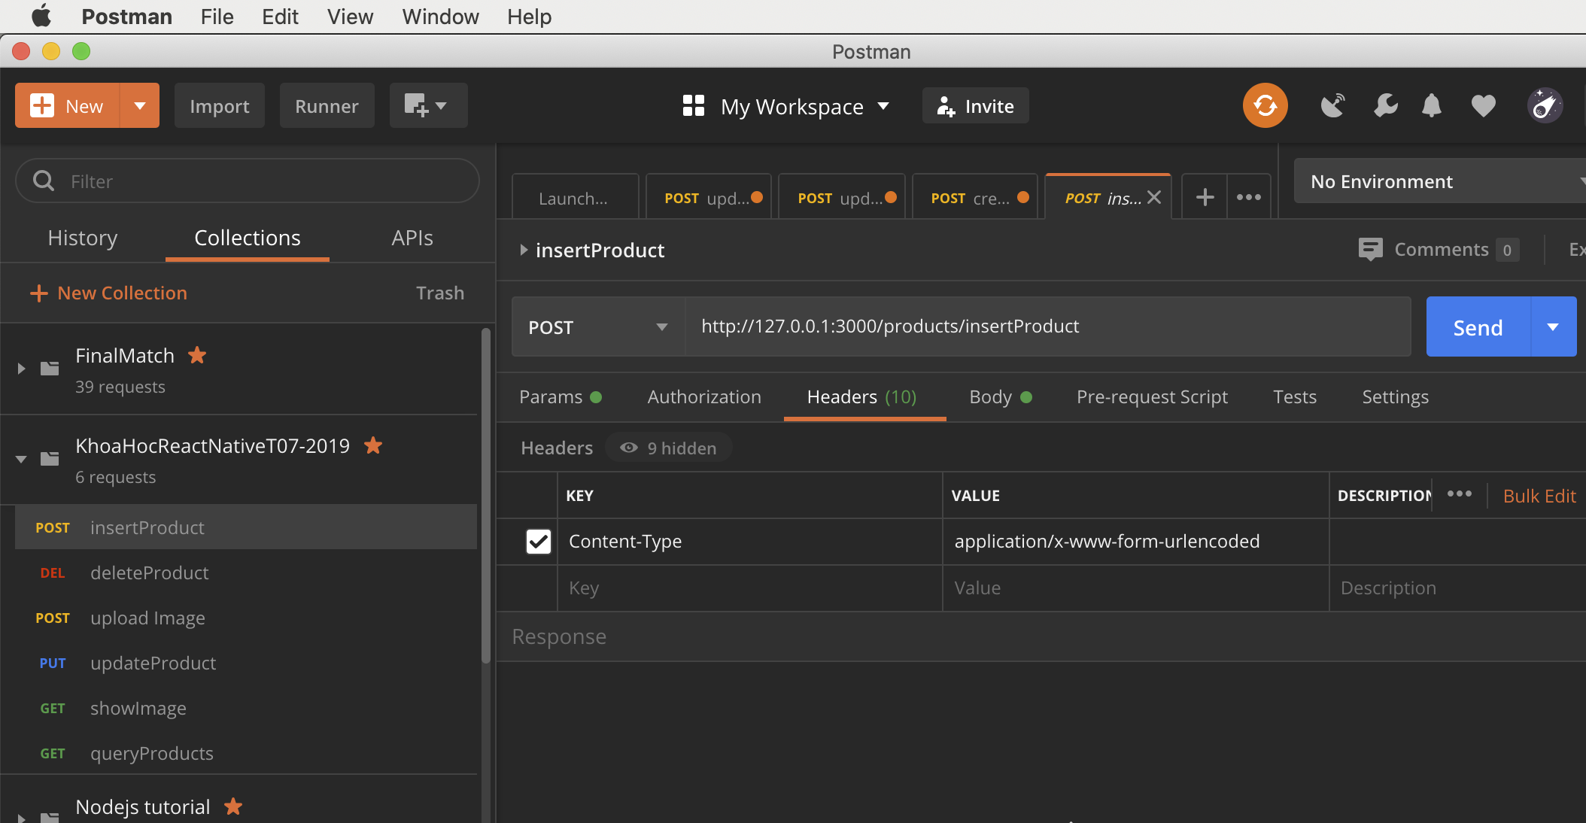
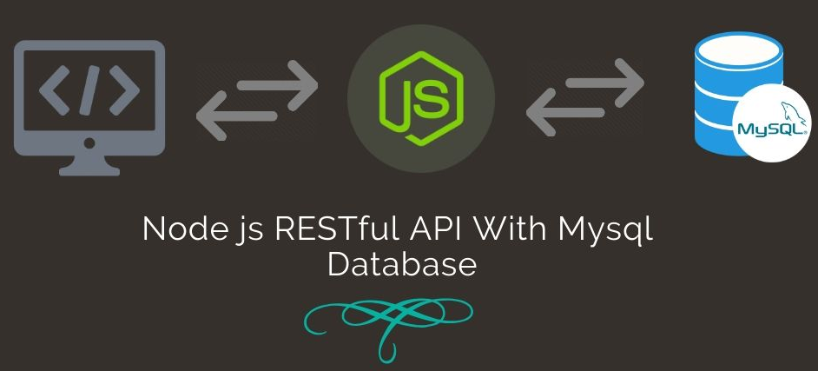
Test API using Postman
Postman's features simplify each step of building an API and streamline collaboration so you can create better APIs—faster

Slide 16
Upload images to NodeJS Server
Simple express middleware for uploading files, using express-fileupload
//In server.js
const fileUpload = require('express-fileupload')
app.use(fileUpload({
limits: { fileSize: 50 * 1024 * 1024 }, //Maximum = 50 MB
}))
//In "router" file
router.post('/uploads', async (req, res) => {
//Data is saved in req.files
//Insert this code inside try...catch, why?
if(!req.files || Object.keys(req.files)) {
//Cannot find files to upload
return
}
keys.forEach( async (key) => {
//create file, save files to server
})
})

Slide 17
Upload images to NodeJS Server
Save your files to a folder in Nodejs server
const fileName = `${Math.random().toString(36)}`
const fileObject = await req.files[key]
const fileExtension = fileObject.name.split('.').pop()
const destination = `${path.join(__dirname,'..')}/uploads/${fileName}.${fileExtension}`
let error = await fileObject.mv(destination) //mv = move
if (error) {
res.json({
result: "failed",
message: `Cannot upload files. Error: ${error}`
})
return
}
if (key === keys[keys.length - 1]) {
//response "Upload files successfully"
}

Slide 18
Access your image by GET request
Client can access images from your server by sending a GET request
router.get('/getImage', async (req, res) =>{
let {fileName} = req.query
const destination = `${path.join(__dirname, '..')}/uploads/${fileName}`
try {
fs.readFile(destination, function(err, data) {
//if (err) => ?
res.writeHead(200, {'Content-Type': 'image/jpeg'});
res.end(data); // Send the file data to the browser.
});
} catch(error) {
//show error?
}
})

Slide 19
Authentication Strategies: Session vs JWT
-JSON Web Tokens(JWT): It relegates part of the authentication responsibility to the client and makes them sign a token that’s sent with every request, to keep the user authenticated
-Session-based authentication: This method relegates the weight of the authentication to the server. It uses cookies and sees the Node application and database work together to keep track of a user’s authentication state.

Slide 20
Authentication with Passport
And we’ll need to install the express-session middleware
router.get('/getImage', async (req, res) =>{
let {fileName} = req.query
const destination = `${path.join(__dirname, '..')}/uploads/${fileName}`
try {
fs.readFile(destination, function(err, data) {
//if (err) => ?
res.writeHead(200, {'Content-Type': 'image/jpeg'});
res.end(data); // Send the file data to the browser.
});
} catch(error) {
//show error?
}
})//We will practice detail on the class/lab

Slide 21


